Slide 1
first encounter with
LABEL DESIGNER
WinMix Additional Modules

Slide 2
Using special «Label Designer», you can clearly and quickly create a label, which will look the same as you need
Fast
Descriptive
Easy
Try it and you will love it

Slide 3


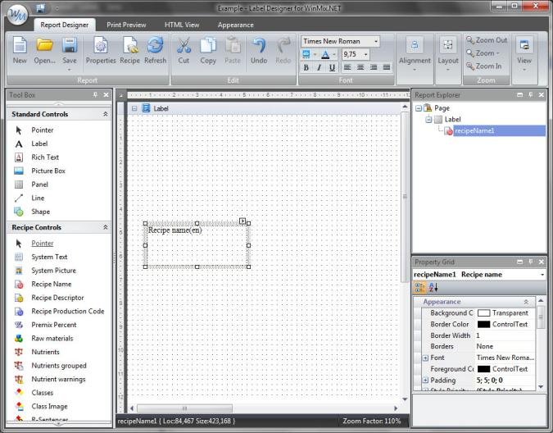
EASY
All the parameters that contain the recipe, are components of the editor, and located on the left panel of “Designer”. To add them to the label, simply drag them with the help of mouse to the desired location of the layout.

Slide 4


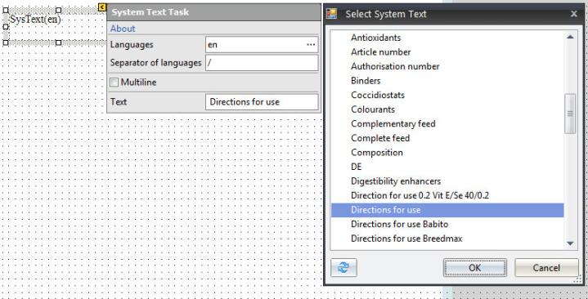
In a similar way you can add to the label any line, text, system text, logo, picture or bar-code.
The text, which is used more than once or in different labels, you can write to the database of "System texts". Then, to add such a text you may simply add the component of "System text" and select the necessary text in the drop-down list.
FAST

Slide 5

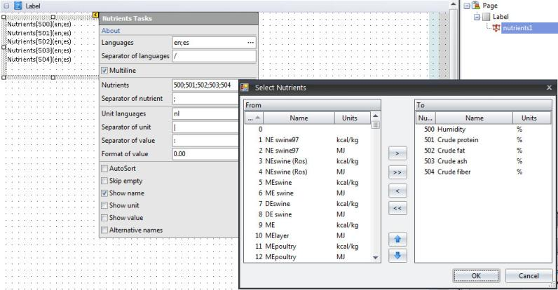
When you add a component that can contain multiple elements, such as nutriets or raw materials, you can choose from a database elements which will be printed out in this block.
Descriptive

Slide 6
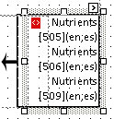
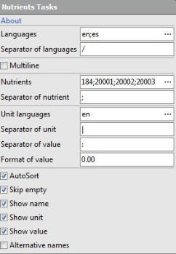
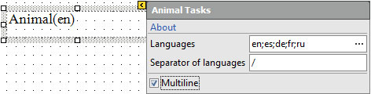
Control the position and size of each block is very simple - using the mouse you can drag the block or make it bigger or smaller.
If you add a component, which may consist of two or more numbers of rows, then in parameters of the block you can choose the type of separator, type of placement (multiline) and other appearance settings.
«Label Designer» supports over 22 languages, and if you need we can add any other language. You can select one or more languages for each parameter of your label.

Slide 7

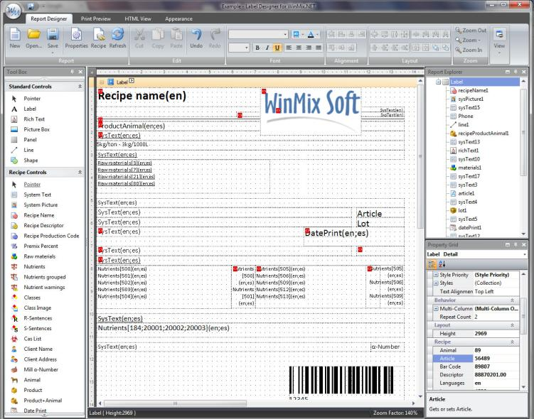
Example of label design

Slide 8
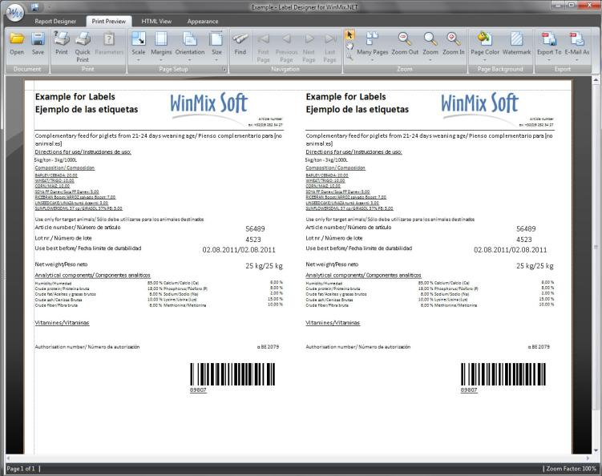
Example of label print preview

Slide 9
ask our manages about
LABEL DESIGNER
WinMix Soft Ltd.
Ukraine, Kyiv
+380 (44) 331-56-51
support@winmixsoft.com
http://www.winmixsoft.com

