Slide 1
Optimal feeding recipes –
Basis of profitable animal farming
Inessa Alekseenko
PhD, project manager
WinMixSoft Ltd.

Slide 2
Not balanced recipe
1
2
3
NOT
satisfy needs of the animals
NOT
optimal
NOT
relevant
characteristics
Notes:
Not balanced recipe it`s a recipe that:
Does NOT satisfy needs of the animals. Does not have the right amount of all the nutrients needed for good health and growth of the animal;
Not optimal. With all the necessary nutrients is not the cheapest one with the available raw materials;
Not relevant, if while the calculation is not possible to take into account the rapidly changing resource base and choose the most suitable material automatically from several options;
when calculating manually without any program very high probability of error.

Slide 3
Not balanced recipe
1
2
3
low weight gain and milk production
huge decrease of profitability
unreasonable spending of time and resources
consequences
Notes:
All these leads to:
low weight gain and milk production;
huge decrease of profitability;
unreasonable spending of time and resources

Slide 4
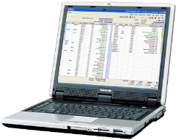
Calculation using the computer program
1
2
fast and convenient calculation of recipe
recipe that meets all norms of feeding
3
4
guaranteed weight gain, milk production and profit increase
recipe that
has the lowest possible cost
advantages
Notes:
Computer programs for calculating a recipes are developed and used worldwide. This is essential tool that can significantly simplify the work of nutritionists, make calculation convenient and fast, and most importantly to get the most optimum variant according to the norms of feeding for the lowest possible price, and thus ensure good weight gain, milk production and profit.

Slide 5

Getting results with WinMix
Type of animal, weight, age
Raw materials
Feeding Template for this category
of animals (or set of nutrients)
Price-list
set of raw materials,
min-max and
additional limits to
their content
in the recipe
set of nutrients, minimum and
maximum limits on their content
in the recipe and additional limits
(nutrients ratio, sum etc.)
Cost of raw
materials
in the recipe
The most optimal result : balanced
feeding recipe at the lowest cost
Notes:
Simplified scheme of creating a recipe using the WinMix:
Depending on the animal type, as well as its weight or age user selects a template feeding from database.
The template can be selected from the database or created from zero based on your own data and knowledge. And it can include: set of nutrients, minimum and maximum limits on their content in the recipe and additional limits (nutrients ratio, sum etc.).
Then user selects the raw materials, which he plans to use in the recipe and sets the necessary min-max limits (it can be the raw materials, which he has in the stock, as well as client`s raw materials).
Then user chooses price-list with raw materials prices from database or manually sets it directly in the recipe.
All these data are processed in the program for a few seconds, and the user receives a balanced optimum recipe at the lowest possible price. Or in other words a guidance, how much of each raw materials need to take to get all the nutrients in the required amount.

Slide 6
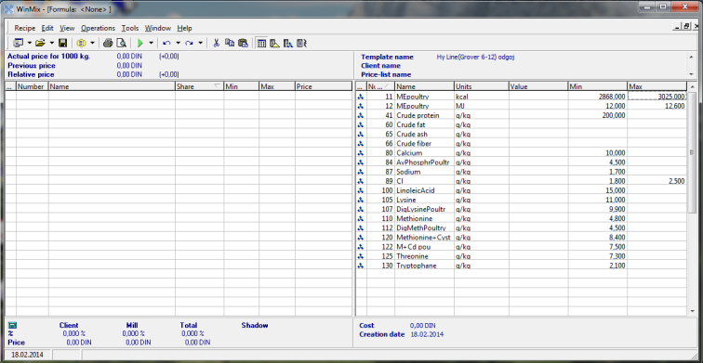
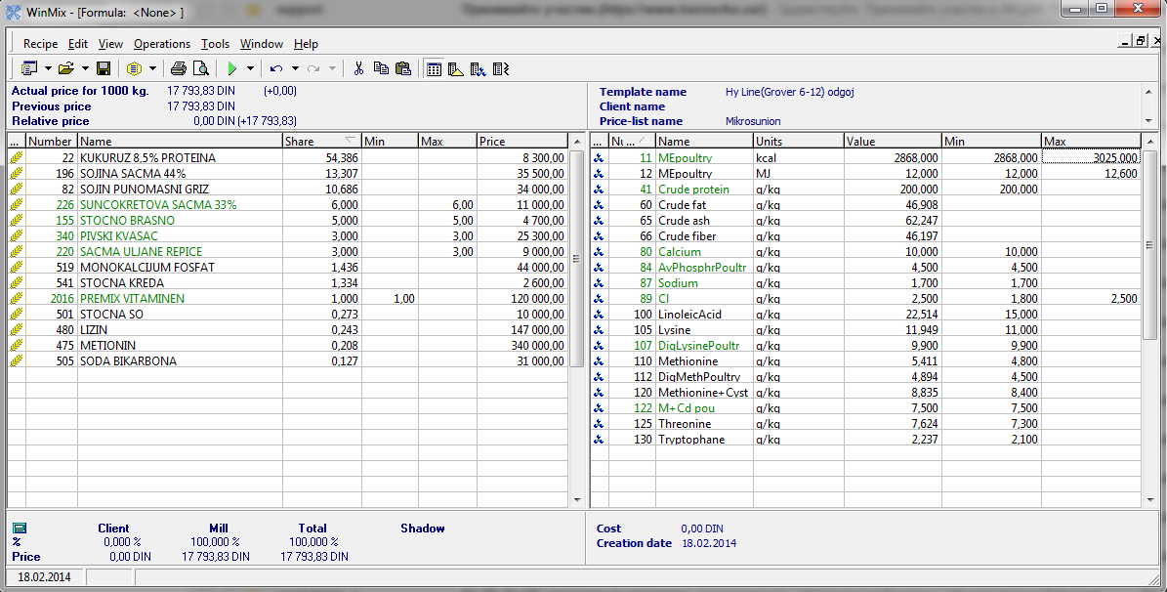
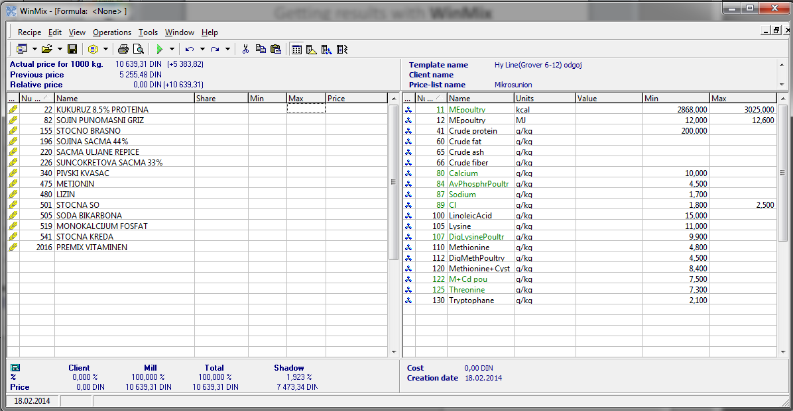
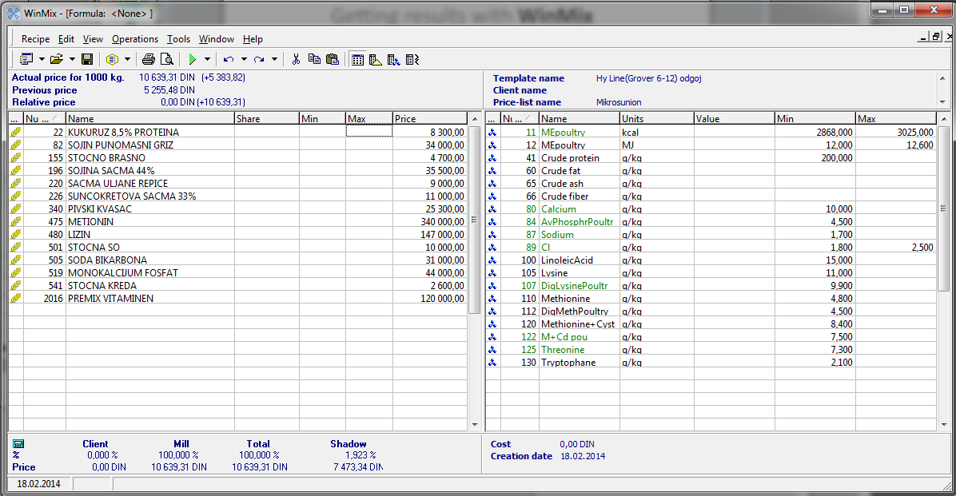
Getting results with WinMix
Notes:
Recipe for example: at first we choose the template in right part with list of nutrients and min-max limits, then the list of raw materials in left part, then choose the price-list and set up a several limits on raw materials. We run optimization and get result, which you can see in columns Share and Value – as I already said how much of each raw materials need to take to get all the nutrients in the required amount.

Slide 7
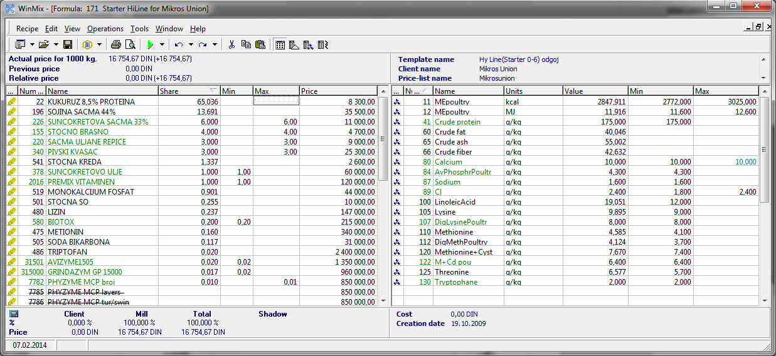
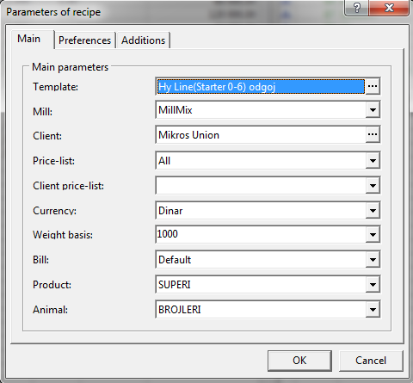
Templates, currencies, clients in recipe
Notes:
WinMix has a lot of useful features.
You can use different templates, price-lists, currencies, clients in recipe and easily change them in the parameters of the recipe whatever you need.

Slide 8
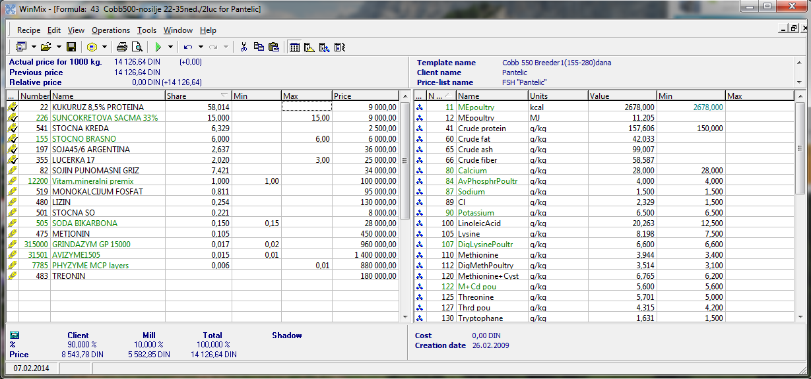
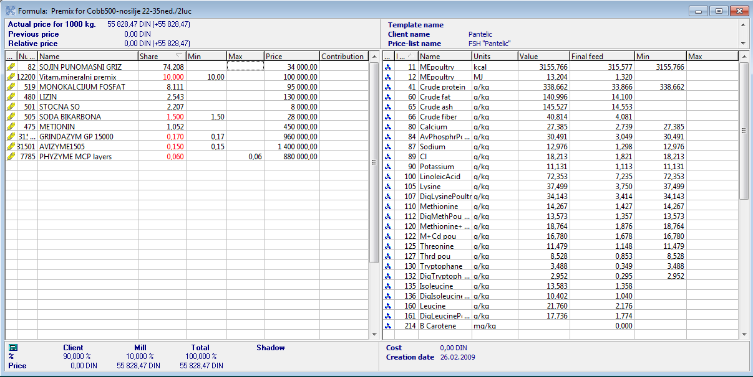
Create premix, additive or concentrate based on clients raw materials
x% 100%
Notes:
By one click you can Create premix, additive or concentrate based on client`s raw materials. Thereby composition of the raw materials which is included in the additive will be transferred to the new recipe and recalculated to 100%.

Slide 9
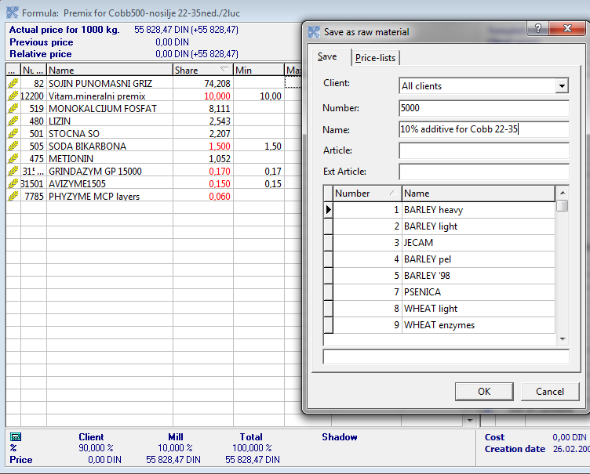
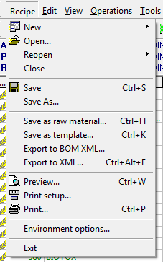
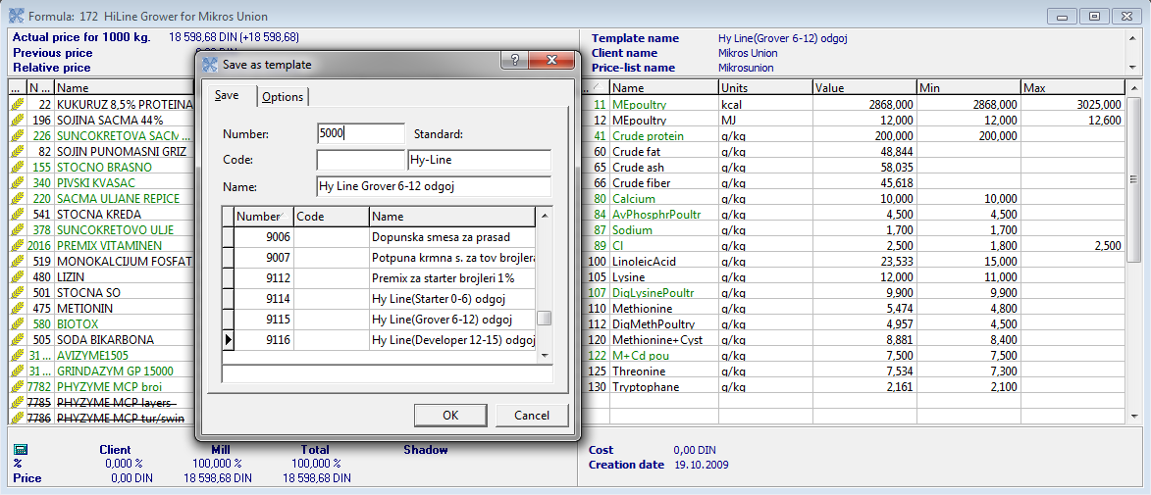
Save recipe as raw material or template
Notes:
Any recipe can be saved as raw material (it`s very useful for premixes), so it can be saved in database as one record with its nutrients values and price for further use. Also recipe can be saved as template with sets of raw materials, nutrients and all limits.

Slide 10
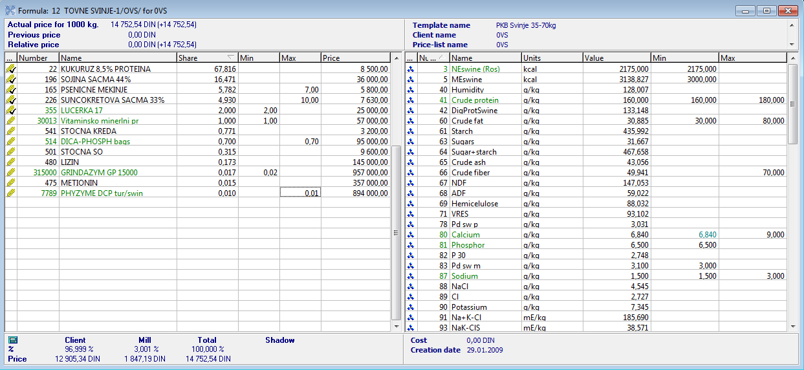
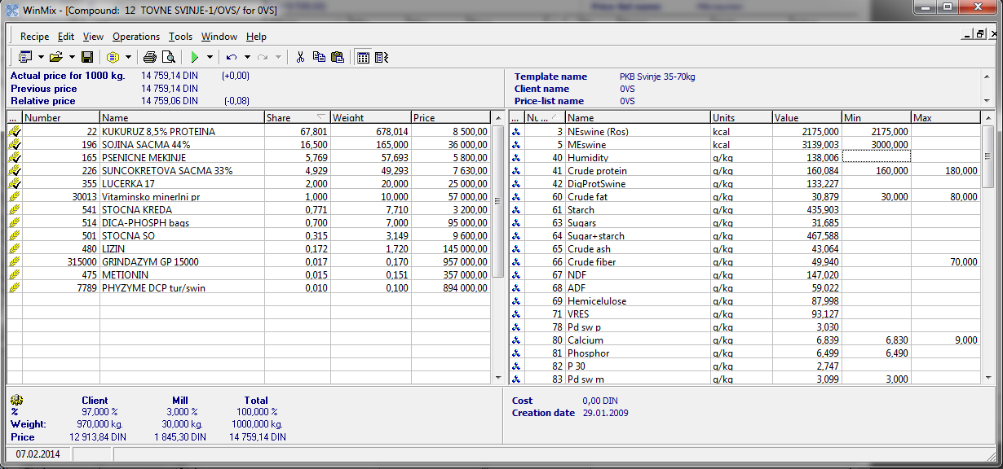
Convert formula recipe into compound
% kg
Notes:
Formula recipe can be converted into compound at any weight (% -> kg). On example it converted to 1tona, but it can be any other specific weight.

Slide 11
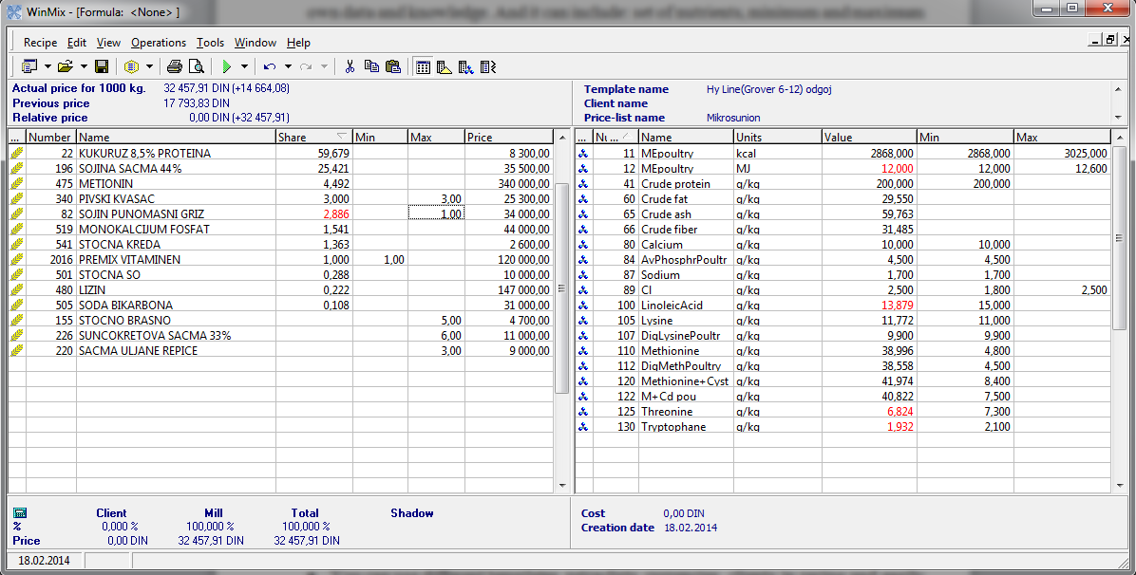
System of colors
Notes:
WinMix has system of colors for convenient calculation and easy recognition of different situation while getting result. On example we have unacceptable values highlighted by special color. It`s not only notification that something wrong, but also hink how to solve the current situation. Result can be achived if we change limit for 1 highlighted raw material in left part or change several highlighted limits in right part or we can add other raw material which have the necessary nutrients.
If some of values equal to one of the limits, such values are displayed in green color as critical. It may mean that they were hard to satisfy or there is an opportunity to reduce the cost recipe by slight changing of limits. If you changed limits or prices in recipe these figures are displayed in blue-green, as warning that this values are differ from the ones in template or in price-list.

Slide 12
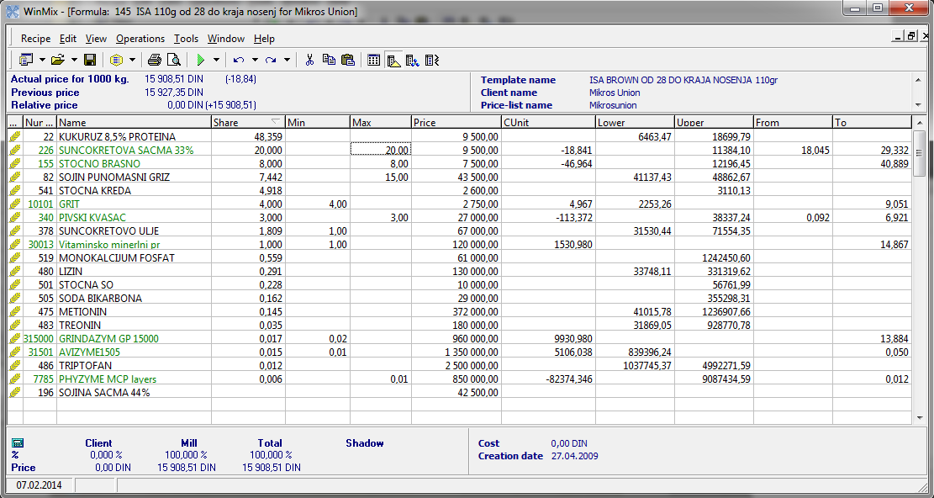
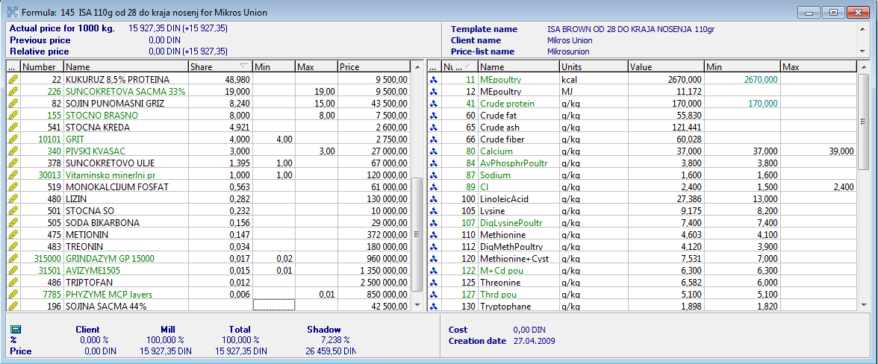
Use “shadow prices" tracking and post-optimization analysis
Notes:
“Shadow prices" tracking and post-optimization analysis can be useful when you try to find a way to reduce the cost.
Shadow % and Shadow Price are displayed only for raw material, which has empty value in the Share field. They show at what price the raw material suitable for this recipe and in what quantity it would be included in case of such price.
CUnit it`s Value of change of recipe price if Raw material quantity changes by 1. For example you can see how recipe price changed for CUnit value (which is18,84 din) when I changed maximum of Сунцокретова сачма from 19 to 20.
Lower and Upper columns display Maximum and minimum Raw material price values, at which this Raw material quantity remains unchanged in the recipe composition.

Slide 13
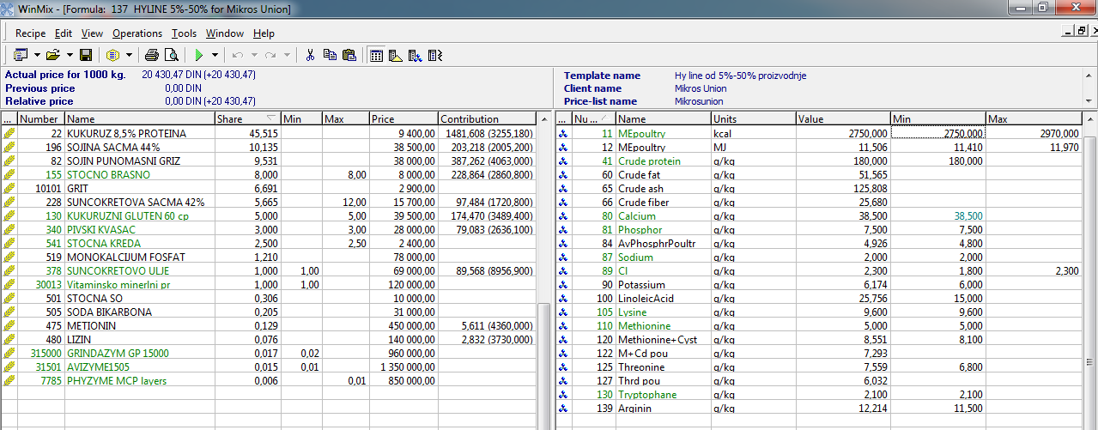
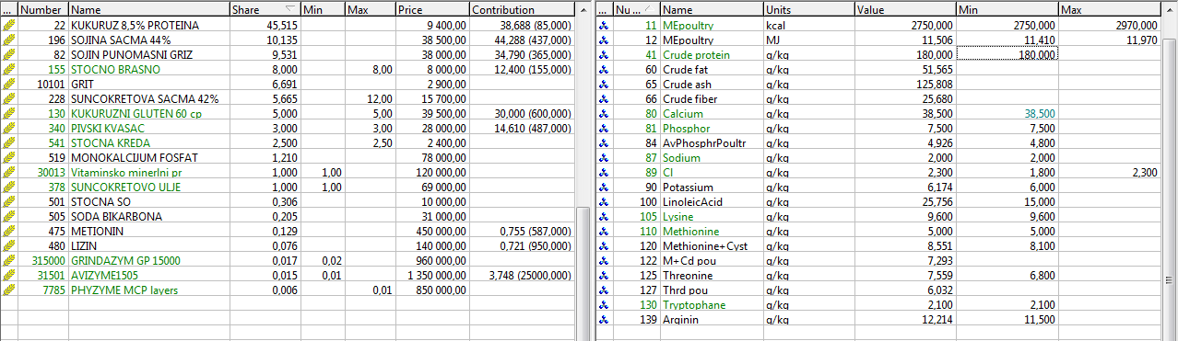
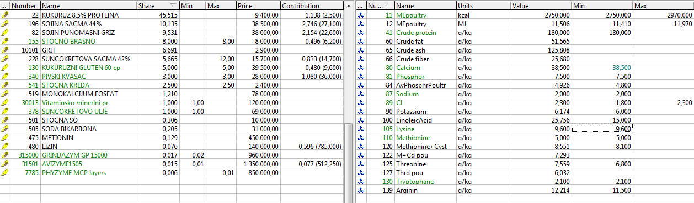
Contribution column
Notes:
Contribution column, very useful when you want to see clearly how you get such nutrients values in the recipe. By choosing a specific nutrient in the recipe, you can see in contribution column first figure, what raw materials in what quantities given this nutrient in the recipe, the second figure in parentheses shows the total amount of this nutrient in the raw material.

Slide 14
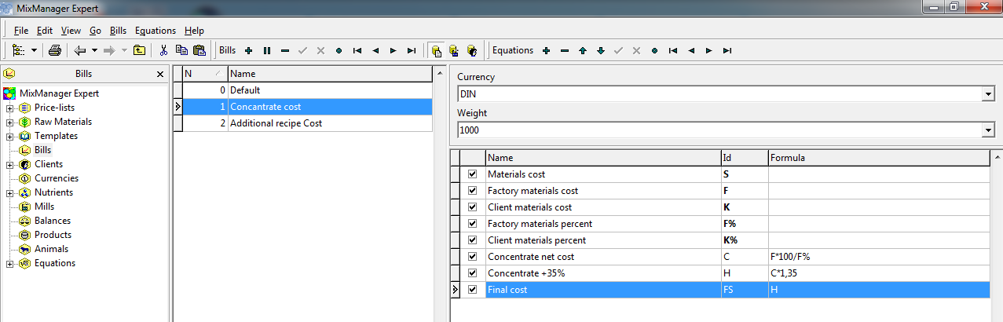
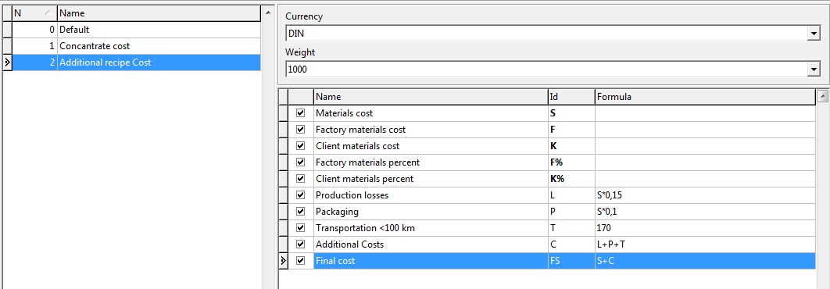
Calculate the final cost of the recipe
+ packaging, production costs, transportation etc.
Notes:
You can Calculate the final cost of the recipe taking into account packaging, production costs, transportation, or other extra costs.
In the recipe window you can see not only actual price for 1000 kg, but also final cost of recipe or premix depending on the bill which you created and chose in recipe parameters. For example, the bill for calculating concentrate cost includes formulas for concentrate net cost calculation and increase of its cost for 35%. The other bill for recipe cost includes formulas for production losses, packaging and transportation.

Slide 15
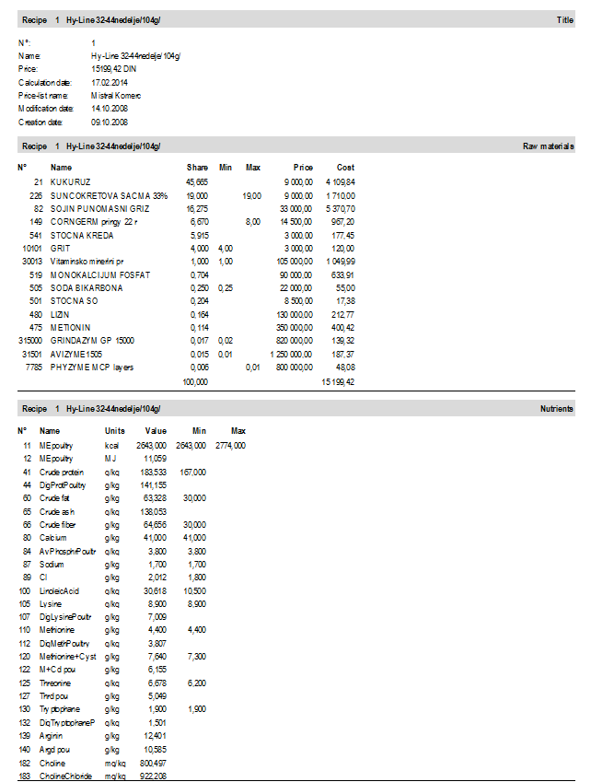
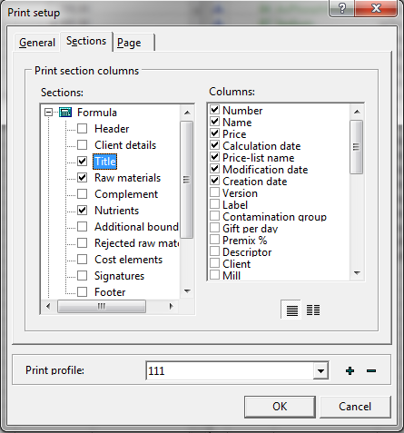
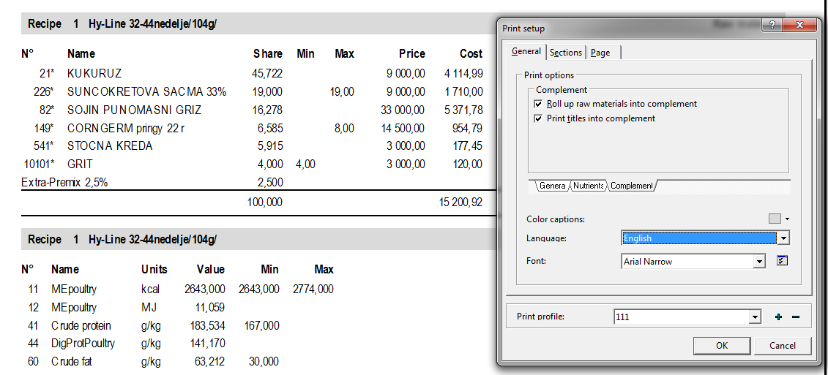
Professional printout
Notes:
WinMix has professional print out. You can create print profiles and choose different parameters for printing for each type of recipe. You can change the view of document to print, by assigning visibility and positioning of print document elements. If you want to see any element on print out – you just need to check it and vice versa. If you don`t want to show client the premix composition you can hide it and print only its name with quantity

Slide 16
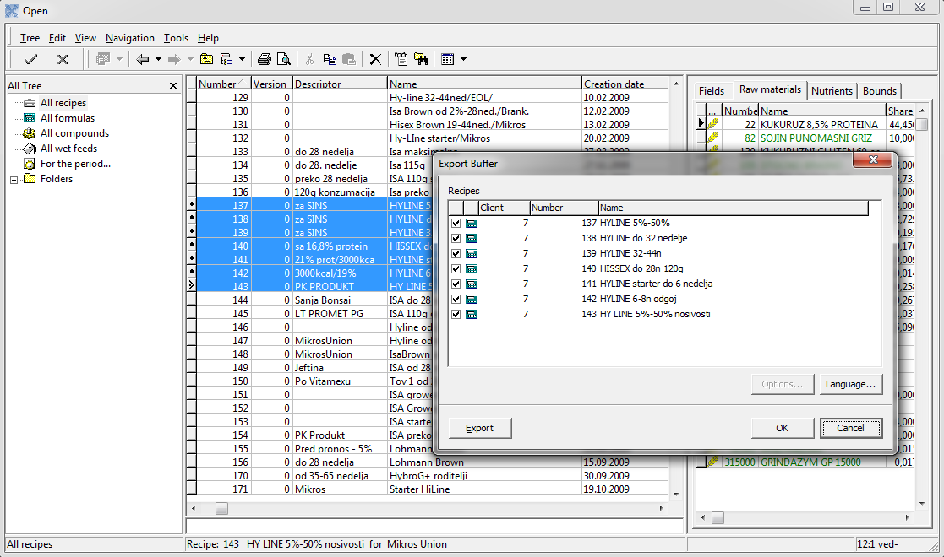
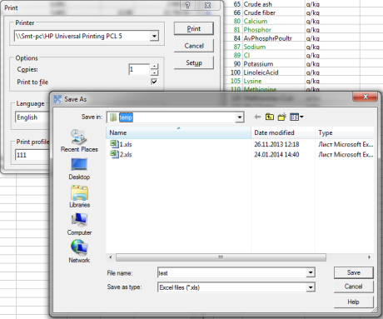
Export and import data, save recipe in .xls and .pdf formats
Notes:
You can Export and import data between different computers, as well as save recipe in .xls and .pdf formats to send it by e-mail.

Slide 17
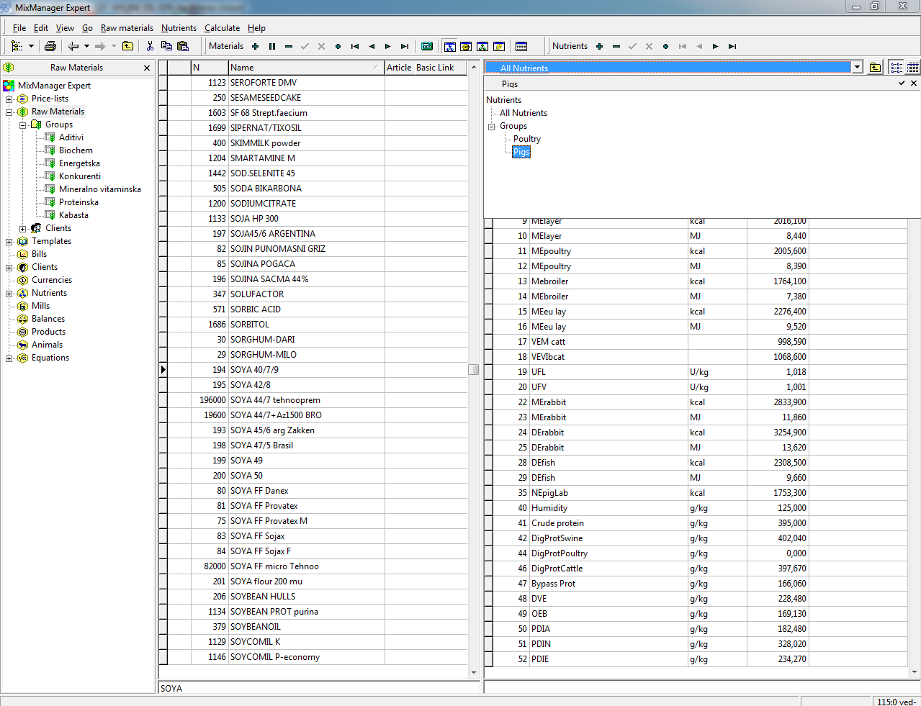
Convenient search and data filters
Notes:
WinMix has convenient search and data filters for elements, for example if you do not want to see in raw materials database all nutrients and need only part of them which are used for pigs only you can choose the corresponding group of nutrients.

Slide 18
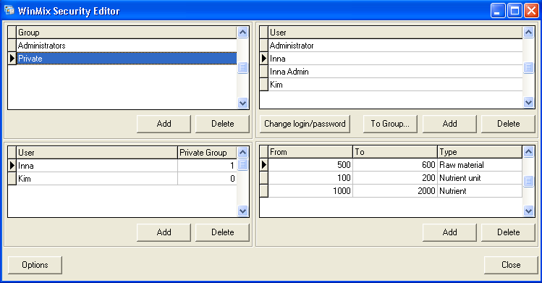
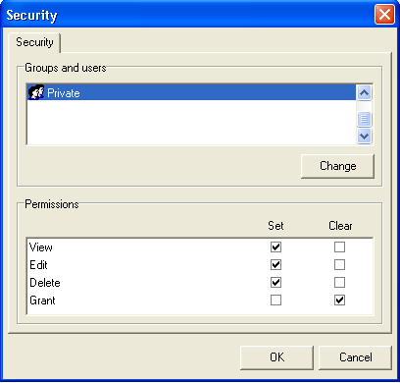
Server version for multiple users with different access rights, database synchronization
Notes:
WinMix has Server version for multiple users which can work directly on server with the same database. Uses may have different access rights to each type of element. Also they can use local version of program and periodically make synchronization between server and local databases so that they were identical.

Slide 19
Calculation of nutrients values
formulas
Crude protein
Crude fiber and ash
Crude fat
Dry matter
Calcium and phosphorus
Metabolic energy
Net energy
Cystine: common and digestible
Threonine: common and digestible
Tryptophan: common and digestible
Digestible protein
Available phosphorus
Lysine: common and digestible
Methionine: common and digestible
Other amino acids

Slide 20
While choosing a program pay attention to the following:
Functionality
Database
Terms of purchase
Support
Simplicity of learning
Ability to add new features
Reliability of the developer
Notes:
If you are choosing a program for least-cost optimization pay attention to the following:
Functionality. Set of necessary features in the program. What functions or modules are available separately from the basic one for additional cost.
Database. What data is already included in the program, how to add new elements. Is it possible to recalculate nutrients values according basic nutrients.
Price and Terms of purchase. What is the cost of the program, additional modules or functions, if they exist, as well as support, updates, and training.
Support. Updates, hotline, operational support for troubleshooting, which ensure the smooth operation of the program.
Easy learning. How convenient and intuitive the program interface and to perform the necessary actions while working.
Modernization. Are there opportunities to modify the program to the requirements of a particular client, for example, to export data to a program at the factory and / or to the accounting software and others.
The developer reputation. How many years the program on the market, is there any positive recommendation from clients.

Slide 21

WinMix.Cattle module for rations

Slide 22
Calculation of nutrient requirements
VEM (Energy, feed unit milk)
DVE (Intestine Digestible Protein)
Structure value
Satiety value
Calcium
OEB (Degradable Protein Balance)
FOS (Fermentable Organic Matter)
Digestible Amino Acids
Phosphor
Mg, Na
Dry Matter
K, Cl
Fe, Cu
Other microelements
model
Weight of animal
Number and day of lactation
Day of pregnancy
Planned milk production
Planned fat and protein content in milk

Slide 23
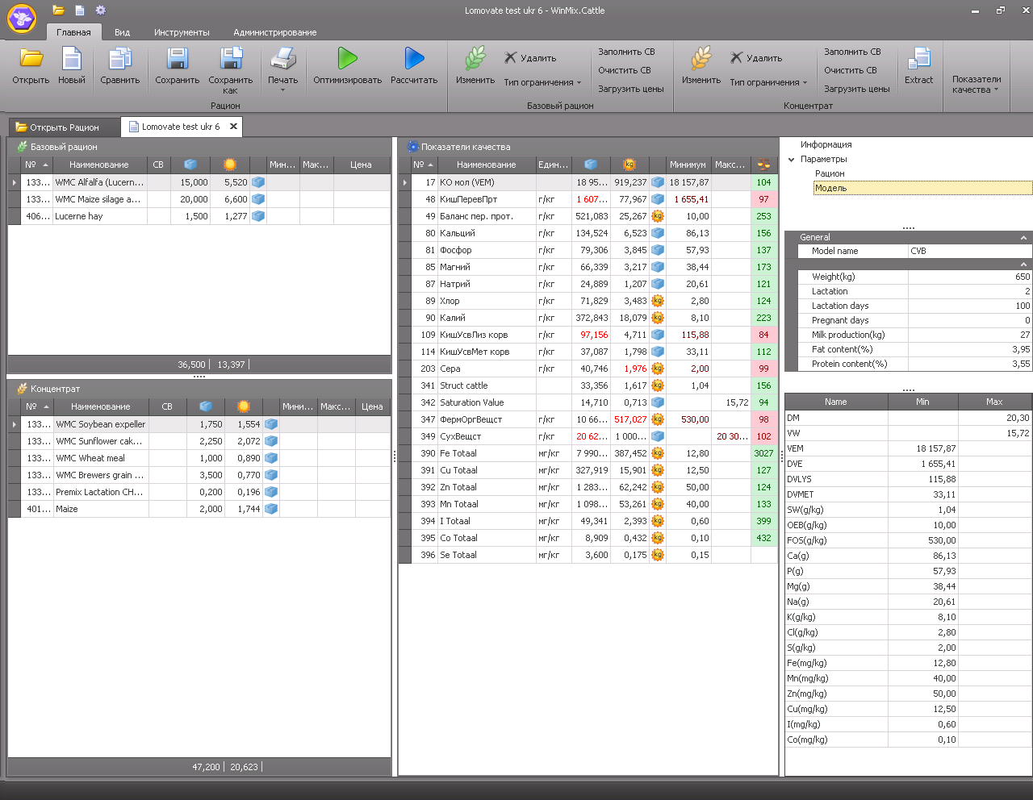
Ration calculation in WinMix.Cattle

Slide 24
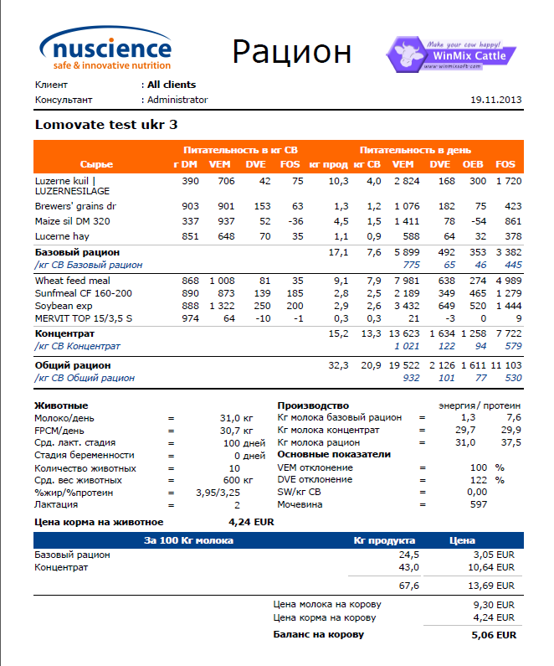
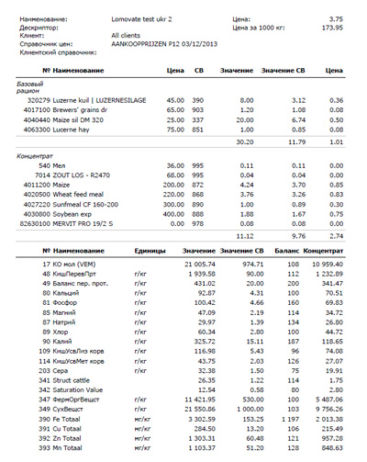
Ration print in WinMix Cattle

Slide 25





Inessa Alekseenko
PhD, project manager
WinMixSoft Ltd.
+380 67 505-12-05
+380 44 331-56-51
kim@winmixsoft.com
http://www.winmixsoft.com
Optimal feeding recipes –
Basis of profitable animal farming
Thank you

